Slide 1



Software Engineering CS411, FALL 2025
Lecture 13: Introduction to Software Testing
By Prof. Mohamad Kassab
Leonidas Kontothanassis kthanasi@bu.edu

Slide 2

Lesson plan
Gain insight into the rationale for software testing.
Acquire knowledge of fundamental terminology used in software testing.
Appreciate the significance of utilizing testing management tools.

Slide 3

Some Famous Bugs
The first bug discovered?
NASA Mariner 1 Venus probe, 1962
Therac 25, 1987
European Space Agency Ariane 5 Rocket, 1996
NASA Mars Pathfinder rover, 1997
NASA Mars climate orbiter, 1999
NASA Mars Spirit rover, 2004

Slide 4
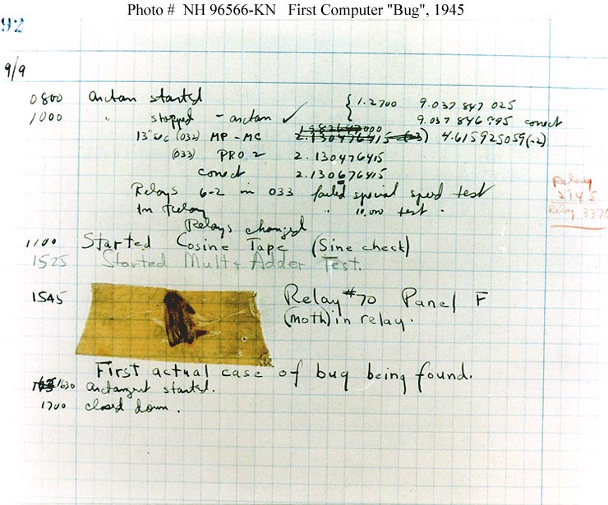
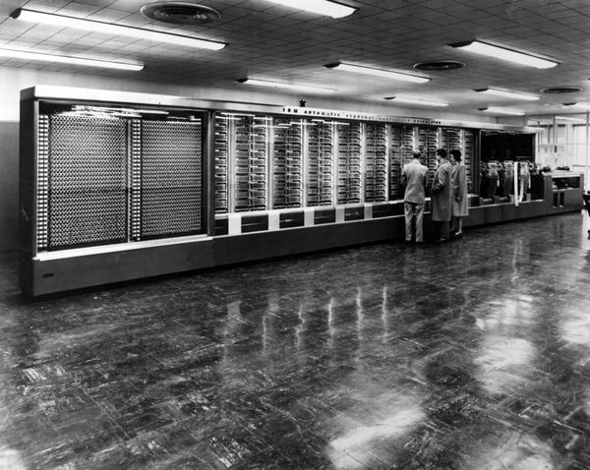
The First Bug Discovered?
The “first bug” discovered in Harvard Mark II by Grace Hopper’s team – notebook in the Smithsonian Institute
Source: Wikipedia, http://en.wikipedia.org/wiki/Image:H96566k.jpg
Notes:
The First "Computer Bug" Moth found trapped between points at Relay # 70, Panel F, of the Mark II Aiken Relay Calculator while it was being tested at Harvard University, 9 September 1947. The operators affixed the moth to the computer log, with the entry: "First actual case of bug being found". (The term "debugging" already existed; thus, finding an actual bug was an amusing occurrence.) In 1988, the log, with the moth still taped by the entry, was in the Naval Surface Warfare Center Computer Museum at Dahlgren, Virginia, which erroneously dated it 9 September 1945. The Smithsonian Institute's National Museum of American History and other sources have the correct date of 9 September 1947 (Object ID: 1994.0191.01). The Harvard Mark II computer was not complete until the summer of 1947. Removed caption read: Photo # NH 96566-KB First Computer "Bug", 1945
Date9 September 1947

Slide 5
NASA Mariner 1 Venus Probe, 1962
An error in a single FORTRAN statement resulted in the loss of the first American probe to Venus
The error was :
Should have been:
Could have been prevented by testing or proper programming technique.
DO 5 K = 1.3
<loop body>
5 CONTINUE
DO 5 K = 1,3
<loop body>
5 CONTINUE
Notes:
Mariner 1 was the first spacecraft of the American Mariner program, designed for a planetary flyby of Venus. It cost $18.5 million in 1962. It was launched aboard an Atlas-Agena rocket on July 22, 1962. Shortly after takeoff the rocket responded improperly to commands from the guidance systems on the ground, setting the stage for an apparent software-related guidance system failure.^{[1]} With the craft effectively uncontrolled, a range safety officer ordered its destructive abort 294.5 seconds after launch.^{[2]}
What is the issue? With the comma it’s a loop. Without it it’s a statement assigning the value 1.3 to the variable DO5K

Slide 6
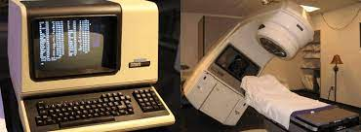
Therac-25, 1987
Between 1985 and 1987 a computer-controlled radiation therapy machine delivered fatal doses to six people.
Software was developed by a single person, using PDP 11 assembly language, over a period of several years.
The software "evolved" from the Therac-6 software, which was started in 1972.
The "program structure and certain subroutines were carried over to the Therac-25 around 1976."
It appears that unit and software testing was minimal, with most effort directed at the integrated system test.
Source: Nancy G. Leveson ,Safeware: System Safety And Computers , Addison-Wesley, 1995

Slide 7
Ariane 5 Rocket, 1996
Unmanned rocket crashed 30 seconds into flight due to complete loss of guidance and attitude information.
Lost information caused by data conversion from 64-bit floating point to 16-bit signed integer value.
The floating-point number which represented an acceleration had a value greater than what could be represented by a 16-bit signed integer.
16 bits had been sufficient for Ariane 4, but Ariane 5 was a faster rocket.
See https://www.youtube.com/watch?v=5tJPXYA0Nec for video

Slide 8
NASA Mars Climate Orbiter, 1999
Sept. 1999, climate orbiter approaches Mars 170 km too close to surface.
Probe believed to have burned up in the atmosphere.
Ground software used English units, flight software used metric units – caused position calculation error.
Verification and validation processes failed to ensure that software met requirements.
Source: System Failure Case Studies, August 2009, Col. 3, No. 05, published by NASA. Available at http://pbma.nasa.gov/docs/public/pbma/images/msm/MCO_SFCS.pdf

Slide 9
Other Notable Software Caused Catastrophes
Numerous oil rig incidents
2010 Toyota Prius braking system?
2003 Northeast power outage
1994 Denver airport baggage handling system.
Boeing 737 Max
Do you have examples?
Notes:
Steipner Platform collagpse Norway. Bad finite element analysis.
Software controlled type of braking (friction vs regenerative)
The reporting system had a bug and was unable to correctly report on all the affecting issues, so operators had inaccurate data on which to operate
Meta system failure with inability to come back from failure after recovery

Slide 10
What is Software Testing?
“Testing can show the presence of bugs, but never their absence” —
Edsger Dijkstra, Structured Programming, 1972
In general proofs of non-existence are impossible – prove that there is no Santa Claus!

Slide 11
What is Software Testing?
Software testing is the process of evaluating a software application or system to assess its quality, functionality, and performance.
It involves executing the software with the intent of finding defects or errors, as well as verifying that it meets specified requirements and works as expected.

Slide 12
Why Test Software?
“An ounce of prevention is worth a pound of cure.”
Henry de Bracton’s De Legibus, c. 1240
“In the beginning of a malady it is easy to cure but difficult to detect, but in the course of time, not having been either detected or treated in the beginning, it becomes easy to detect but difficult to cure.”
Nicolo Machiavelli, The Prince, 1513
“Pay me now or pay me later!”
Anonymous

Slide 13
Why Test Software?
“To find all possible bugs” (< 1972)
“To demonstrate the absence of bugs” (until about 1980)
“To verify that the code meets its specifications and satisfies the customer – i.e. demonstration of proper behavior” (today…but)
Improve software quality!!!

Slide 14
The Objectives of Testing
What does work
What does not work
Reduce the risk of failures
Reduce the cost of testing
Testing is a lifecycle, quality improvement strategy
In a business context, software requirements specifications are a legally enforceable contract.
Failure to meet specifications (and the discovery of software bugs) can lead to litigation.
Proper testing can help to avoid lawsuits, aggravation, and serious financial penalties.
Notes:
1. YouTube copyright situation. An imperfect system to detect copyright violations was the key in securing reprieve from litigation.

Slide 15
Verification and Validation
Verification
Evaluation of software system that help in determining whether the product of a given development phase satisfy the requirements established before the start of that phase
Building the product correctly (“Am I building the product right?”
Validation
Evaluation of software system that help in determining whether the product meets its intended use
Building the correct product (“Am I building the right product?”

Slide 16

Terminology
Defect – flaw in any representation of the software including the requirements, architecture, design, code or documentation
Fault – defect in the software with the potential to cause a failure
Error – when an event activates fault in a program
Failure – manifested inability of the program to perform its required functions
Bug – colloquial term for fault or defect

Slide 17

What is a Test Case?
Test Case is a simple pair of
<input, expected outcome>
But of course, other information can also be added to a test case. See next slide !

Slide 18
Sample Test Case Template
Title
Author
Classification / Priortiy
Requirement it is linked to
Pre-condition
Steps to execute
Expected Output
Estimated Duration / Effort to Execute

Slide 19
What is a Test Case?
State-less systems: (e.g. compiler)
Test cases are very simple
Outcome depends solely on the current input
State-oriented systems: ATM is a state-oriented system
Test cases are not that simple. A test case may consist of a sequences of <input, expected outcome>
The outcome depends both on the current state of the system and the current input
ATM example:
Test Case 1: < check balance, $500.00 >,
Test Case 2: < withdraw, “amount?” >,
Test Case 3: < $200.00, “$200.00” >,
Test Case 4: < check balance, $300.00 >

Slide 20
The Expected Outcome
An outcome of program execution may include
Value produced by the program
State Change
A sequence of values which must be interpreted together for the outcome to be valid
A test oracle is a mechanism that verifies the correctness of program outputs
Generate expected results for the test inputs
Compare the expected results with the actual results of execution of the IUT
Notes:
IUT = Implementation under Test
SUT = System under Test

Slide 21
The Concept of Complete Testing
Complete or exhaustive testing means
“All possible combinations of input values and all internal code paths are exercised”
Complete testing is near impossible for most of the system
The domain of possible inputs of a program is too large
Valid inputs
Invalid inputs
The design issues may be too complex to completely test
It may not be possible to create all possible execution environments of the system

Slide 22
Exhaustive testing is impractical
Suppose you had a program that consists of six 16-bit inputs and one output that is formed as some combination of those six inputs. To test this software exhaustively, from a black box testing perspective, you would need to test all possible combinations of the six input variables.

Slide 23

Introduction
Exhaustive testing is impractical
For any 16 bit variable there are 2¹⁶ possible values. Thus there are:
2¹⁶ ∙ 2¹⁶ ∙ 2¹⁶ ∙ 2¹⁶ ∙ 2¹⁶ ∙ 2¹⁶ = 2⁹⁶ possible input combinations.
Suppose you automated testing so that you could run one test every 100 microseconds (which is very fast). How much time would you need?
which is 253.7 quadrillion years!

Slide 24
Exhaustive testing is impractical
For any 16 bit variable there are 2¹⁶ possible values. Thus there are:
2¹⁶ ∙ 2¹⁶ ∙ 2¹⁶ ∙ 2¹⁶ ∙ 2¹⁶ ∙ 2¹⁶ = 2⁹⁶ possible input combinations.
Suppose you automated testing so that you could run one test every 100 microseconds (which is very fast). How much time would you need?
which is 253.7 quadrillion years!

Slide 25
The Central Issue in Testing
Divide the input domain D into D1 and D2
Select a subset D1 of D to test program P
It is possible that D1 exercise only a part P1 of P

Slide 26
Testing Activities
Identify the objective to be tested
Select inputs
Compute the expected outcome
Set up the execution environment of the program
Execute the program
Analyze the test results

Slide 27
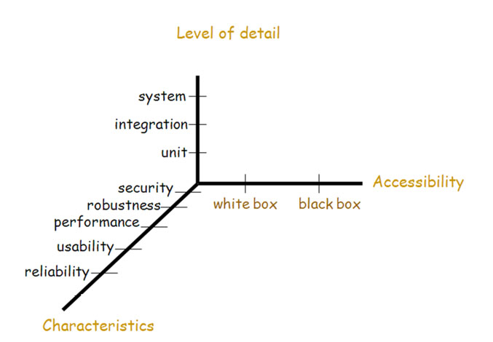
Testing Dimensions

Slide 28
Testing Levels
Unit testing
Individual program units, such as procedure, methods in isolation
Integration testing
Modules are assembled to construct larger subsystem and tested
System testing
Includes wide spectrum of testing such as functionality, and load
Acceptance testing
Customer’s expectations from the system
Two types of acceptance testing
User acceptance testing (UAT)
Business acceptance testing (BAT)
UAT: System satisfies the contractual acceptance criteria
BAT: System satisfies the business goals

Slide 29
Characteristics
Security
Confidentiality, Integrity, Authentication, Validation of Input, Encryption, etc.
Robustness
Handling Invalid input, Resource exhaustion, recovery, failsafe defaults
Performance
Response time, throughput, scaling, utilization, stability under load
Usability
Ease of learning, efficiency, error prevention, accessibility, aesthetics
Reliability
MTBF, MTTR, Data recovery, data persistence

Slide 30

Testing Levels
Unit testing: Does a single object work?
Integration testing: Do multiple objects work together?
System testing: Does my application work?
Acceptance testing: Does the customer like my application?

Slide 31
White-box Testing (Next Lecture)
a.k.a. structural , clear box or glass box
Examines source code with focus on:
Control flow
Data flow
Control flow refers to flow of control from one instruction to another
Data flow refers to propagation of values from one variable or constant to another variable
It is applied to individual units of a program
Software developers perform structural testing on the individual program units they write

Slide 32
Black-box Testing (Next Next Lecture :)
a.k.a. functional testing
Examines the program that is accessible from outside
Applies the input to a program and observe the externally visible outcome
It is applied to both an entire program as well as to individual program units
It is performed at the external interface level of a system
It is conducted by a separate software quality assurance group

Slide 33
Test Planning and Design (After The Break)
The purpose is to get ready and organized for test execution
A test plan provides a:
Framework
A set of ideas, facts or circumstances within which the tests will be conducted
Scope
The domain or extent of the test activities
Details of resource needed
Effort required
Schedule of activities
Budget

Slide 34
Test Planning and Design (After The Break)
Test objectives are identified from different sources
Each test case is designed as a combination of modular test components called test steps
Test steps are combined together to create more complex tests

Slide 35
Monitoring and Measuring Test Execution (After The Break)
Metrics for monitoring test execution
Metrics for monitoring defects
Test case effectiveness metrics
Measure the “defect revealing ability” of the test suite
Use the metric to improve the test design process
Test-effort effectiveness metrics
Number of defects found by the customers that were not found by the test engineers

Slide 36
Test Tools and Automation (After The Break)
Increased productivity of the testers
Better coverage of testing
Reduced durations of the testing phases
Reduced cost of software maintenance
Increased effectiveness of test cases

Slide 37
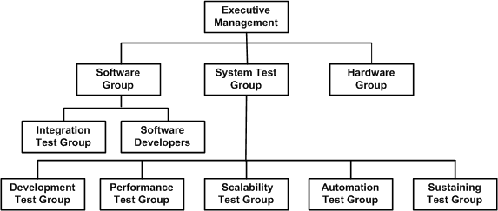
Test Team Organization and Management
Hiring and retaining test engineers is a challenging task
Interview is the primary mechanism for evaluating applicants
Interviewing is a skill that improves with practice
To retain test engineers, management must recognize the importance of testing efforts at par with development effort

Slide 38
Some Immediate Takeaways
Finding and fixing a software problem after delivery is often 100 times more expensive than finding and fixing it during the requirements testing phase.
About 40-50% of the effort on current software projects is spent on avoidable rework.
About 80% of the avoidable rework comes from 20% of the defects.
About 80% of the defects come from 20% of the modules and about half the modules are defect free.
About 90% of the downtime comes from at most 10% of the defects.

Slide 39
Test Cases Management Tools
TestRail
Commercial tool, integration with Jira, GitHub, CI tools, can be expensive
TestLink
Open source, free, widely used, fewer bells and whistles
TestMo
Newer tool, good support for both manual and automated testing, reporting may be less good.
Testiny
TestRail copycat with fewer bells and whistles and lower cost
Zephyr
Less flexible, highly integrated with Zira
SpiraTest
TestRail on steroids, much better tracking,

Slide 40
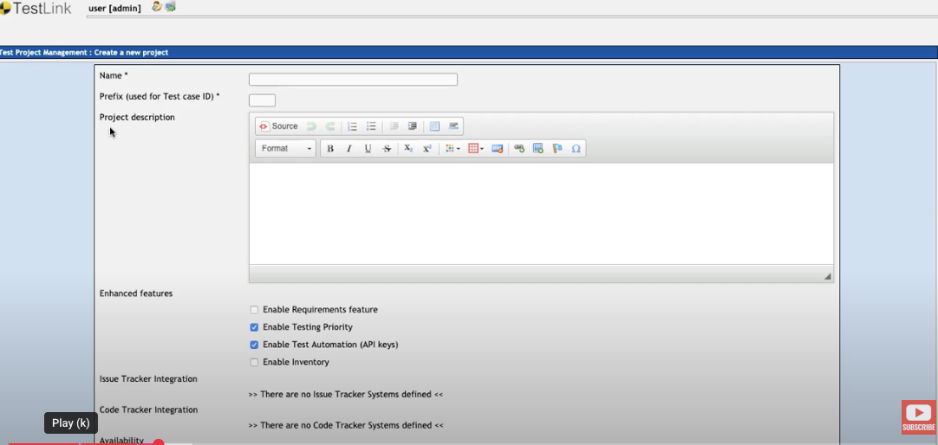
Project Creation
https://www.youtube.com/watch?v=R1BApAdmdTM&list=PLL34mf651faM3OYoEJuwIw-XoNbMXc1ZE&index=1

Slide 41
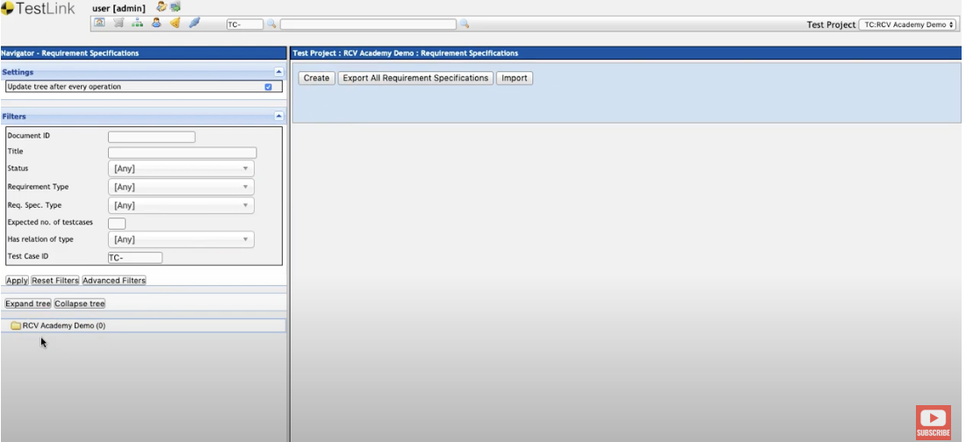
Project Requirements
https://www.youtube.com/watch?v=R1BApAdmdTM&list=PLL34mf651faM3OYoEJuwIw-XoNbMXc1ZE&index=2
https://www.youtube.com/watch?v=R1BApAdmdTM&list=PLL34mf651faM3OYoEJuwIw-XoNbMXc1ZE&index=3
Notes:
This is where you specify the requirements of your project and the number of test cases associated with each. Also attach parts of your requirements document with the corresponding test cases.

Slide 42
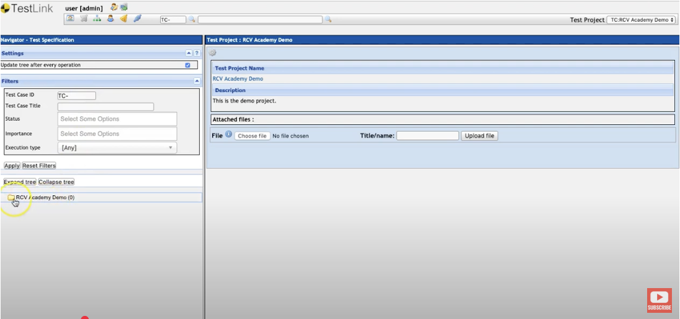
Create TestSuite and TestCases
https://www.youtube.com/watch?v=R1BApAdmdTM&list=PLL34mf651faM3OYoEJuwIw-XoNbMXc1ZE&index=4
https://www.youtube.com/watch?v=R1BApAdmdTM&list=PLL34mf651faM3OYoEJuwIw-XoNbMXc1ZE&index=5
Notes:
This is where you specify the requirements of your project and the number of test cases associated with each. Also attach parts of your requirements document with the corresponding test cases. You will also link the test cases with requirements.

Slide 43
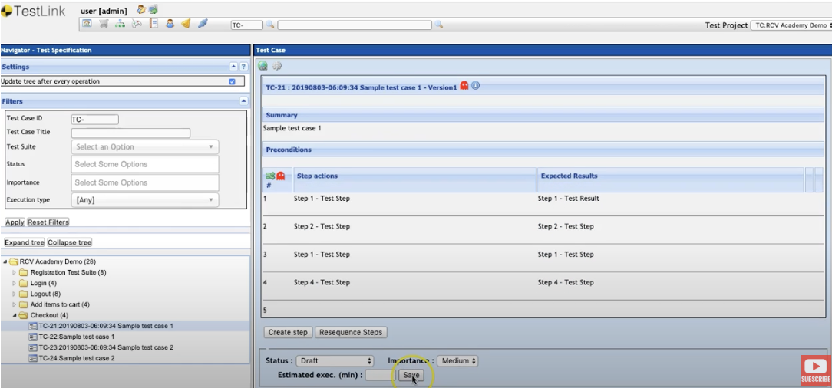
Adding Test Steps and Results to Test Cases
https://www.youtube.com/watch?v=R1BApAdmdTM&list=PLL34mf651faM3OYoEJuwIw-XoNbMXc1ZE&index=6
Notes:
This is where you specify the requirements of your project and the number of test cases associated with each. Also attach parts of your requirements document with the corresponding test cases. You will also link the test cases with requirements.

Slide 44
Adding Platforms, Users, Custom Fields, Keywords, and Inventory
https://www.youtube.com/watch?v=R1BApAdmdTM&list=PLL34mf651faM3OYoEJuwIw-XoNbMXc1ZE&index=7
https://www.youtube.com/watch?v=R1BApAdmdTM&list=PLL34mf651faM3OYoEJuwIw-XoNbMXc1ZE&index=8
https://www.youtube.com/watch?v=R1BApAdmdTM&list=PLL34mf651faM3OYoEJuwIw-XoNbMXc1ZE&index=9
https://www.youtube.com/watch?v=R1BApAdmdTM&list=PLL34mf651faM3OYoEJuwIw-XoNbMXc1ZE&index=10
https://www.youtube.com/watch?v=R1BApAdmdTM&list=PLL34mf651faM3OYoEJuwIw-XoNbMXc1ZE&index=11
Notes:
Platforms = OS, Browsers, other environments
Users = Different types of testers with different access to test cases
Custom Fields = Ignore
Keywords = Other dimensions for organizing tests (i.e. functional vs non functional) so you can get reports on them
Inventory = Hardware you may need to execute your tests cases on

Slide 45
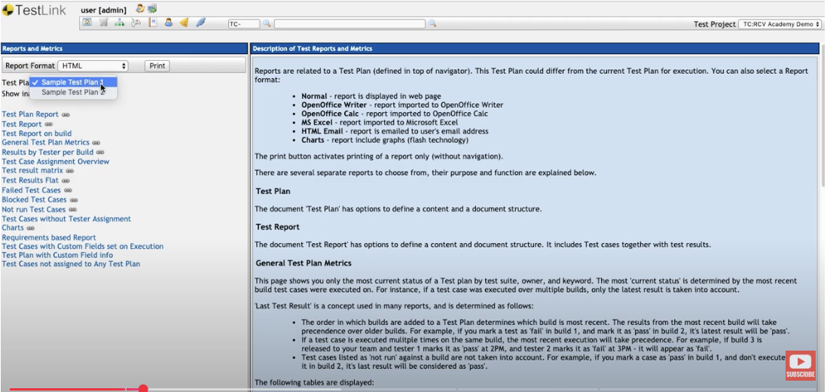
Reports and Metrics
https://www.youtube.com/watch?v=R1BApAdmdTM&list=PLL34mf651faM3OYoEJuwIw-XoNbMXc1ZE&index=12
Notes:
This is where you can easily see the summary of your tests, which ones are passing, how often, compare builds, platforms, etc

Slide 46
Integrating TestRail with CI/CD
@pytest.mark.testrail('C123')
def test_login_valid_user():
...
@pytest.mark.testrail(‘C124')
def test_login_valid_password():
...
$pytest \
--testrail \
--tr-config=testrail.cfg \
--tr-plan-name="Release 1.3 Automated Tests" \
--tr-run-name="Pytest nightly build"
$cat testrail.cfg
[API]
url = https://yourcompany.testrail.io/
email = alex@company.com
password = testrail_api_key_here
[TESTRUN]
project_id = 3
suite_id = 2
plan_id = 5
Notes:
Platforms = OS, Browsers, other environments
Users = Different types of testers with different access to test cases
Custom Fields = Ignore
Keywords = Other dimensions for organizing tests (i.e. functional vs non functional) so you can get reports on them
Inventory = Hardware you may need to execute your tests cases on

Slide 47
Classifying Test Cases
Test-Cases types (according to some employers):
Sanity –very very important test cases
SanityPlus –very important test cases
Acceptance – important test cases
Certification – special test cases required to pass certification
Regular – all other test cases

Slide 48
Life Cycle of the defect (We will speak more on this later in the course)
Created
Assigned
Worked-On
Resolved
Duplicated
Validated
Rejected
Can’t be tested

Slide 49
Test Writing Environments
Highly Dependent on Language, Build System, IDE. Some popular ones include
pytest – For python. Assumes files named test_file.py and methods named test_xxx(). Run with pytest.
JUnit – For Java. Put test code under src/test/java. Integrate with maven, gradle, others.
GTest – For C++. Well integrated with bazel build system but can be made to work with others as well.

Slide 50


Readings , Assignments, Project Tasks
Read:
Chapters 16, 17, 18, 19, 20 of the textbook.
Assignments & Project Tasks:
Project Deliverable 3 is due on Friday. This is a group submission.

Slide 51

Questions

